Slide 1
AD490 Capstone - Transmission Drawings Interface Eric Knigge, Zaya Erdenebileg, Lukas Knezevich

Slide 2
Agenda
Project Description
Development Process
Key Decisions
Key Updates
Next Steps
Demo

Slide 3
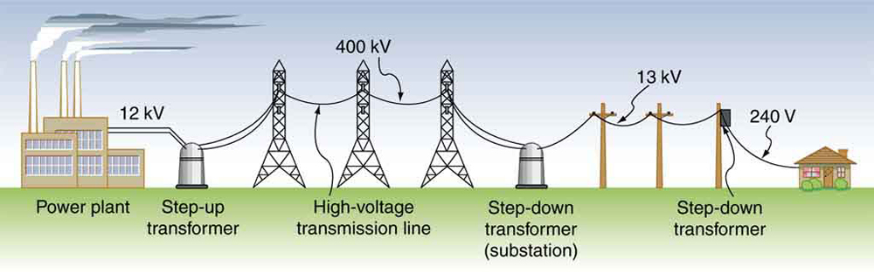
Project Description - Background
Utilities keep records for their larger power structures, known as transmission lines.
Transmission structures are like the highways for electricity.
They are higher voltage and transmit electricity between substations and power generation facilities.
Are often the large metal lattice structures you see, but can take other forms too
We received an engineering drawing database from a local utility, as well as information about how this data is accessed

Slide 4
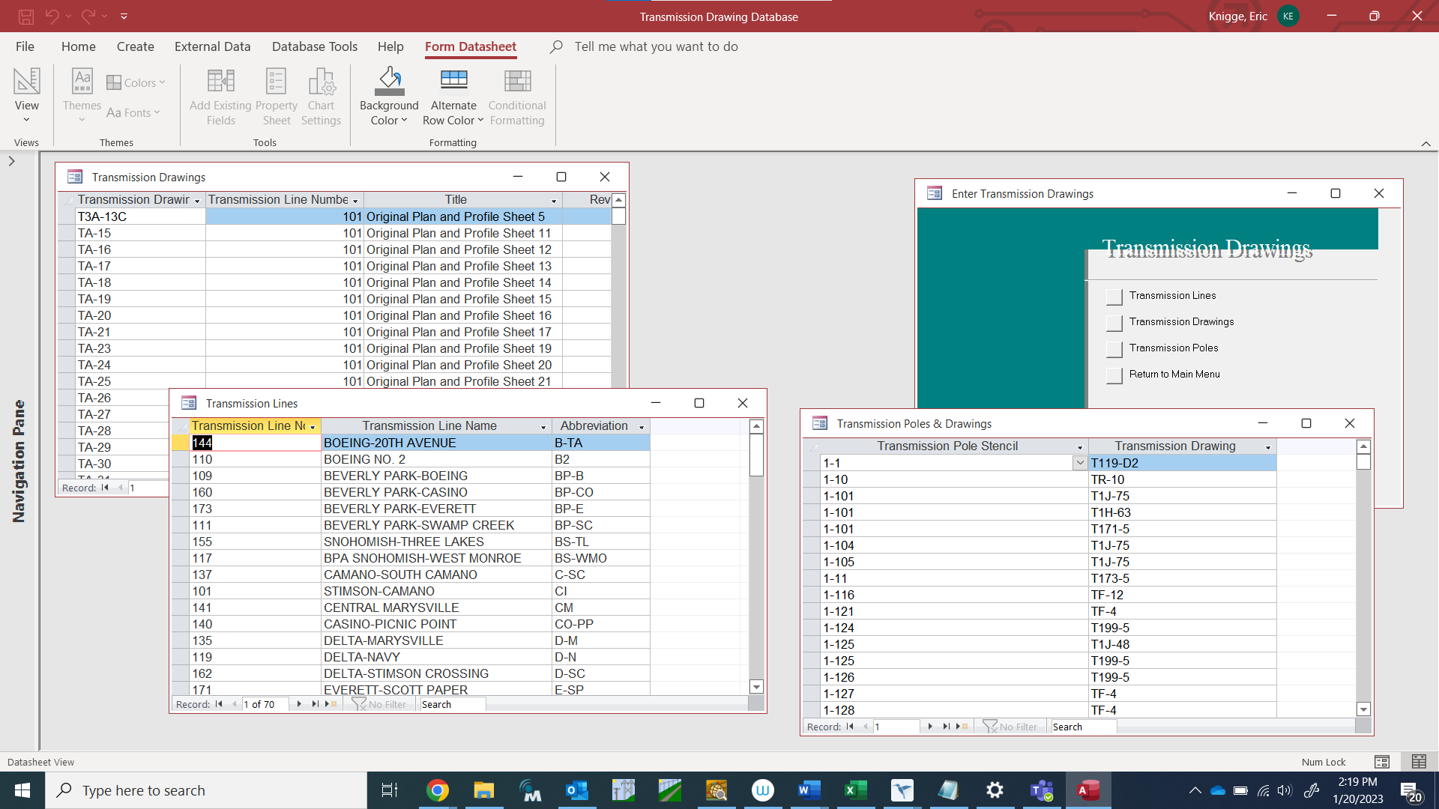
Project Description – Existing Conditions
Microsoft Access is used to open databases and run queries
Service not well-utilized due being slow and non-intuitive
Access forms limits features and extensibility

Slide 5





Project Description – New System
Create web-based interface that functions similarly to a search engine, does not require client software installation
Utilize open-source technologies to keep operational costs to a minimum
Provide a fast and intuitive interface for searching for information
Create an administrative interface for making updates to the system and database

Slide 6

Development – Key Decisions
Simplify technology by using JavaScript as the primary programming language for front-end and back-end tasks, Python for data manipulation and testing, and MySQL for the database
The scope of the project was limited - administration tasks were deferred. This allowed us to focus on core functionality and complete the project before the end of the quarter.
Team members focused on specific areas: one person on back-end, another on front-end, and the other on UI and data graphics.
Everyone was responsible for maintaining their own documentation, but it was reviewed by others.

Slide 7
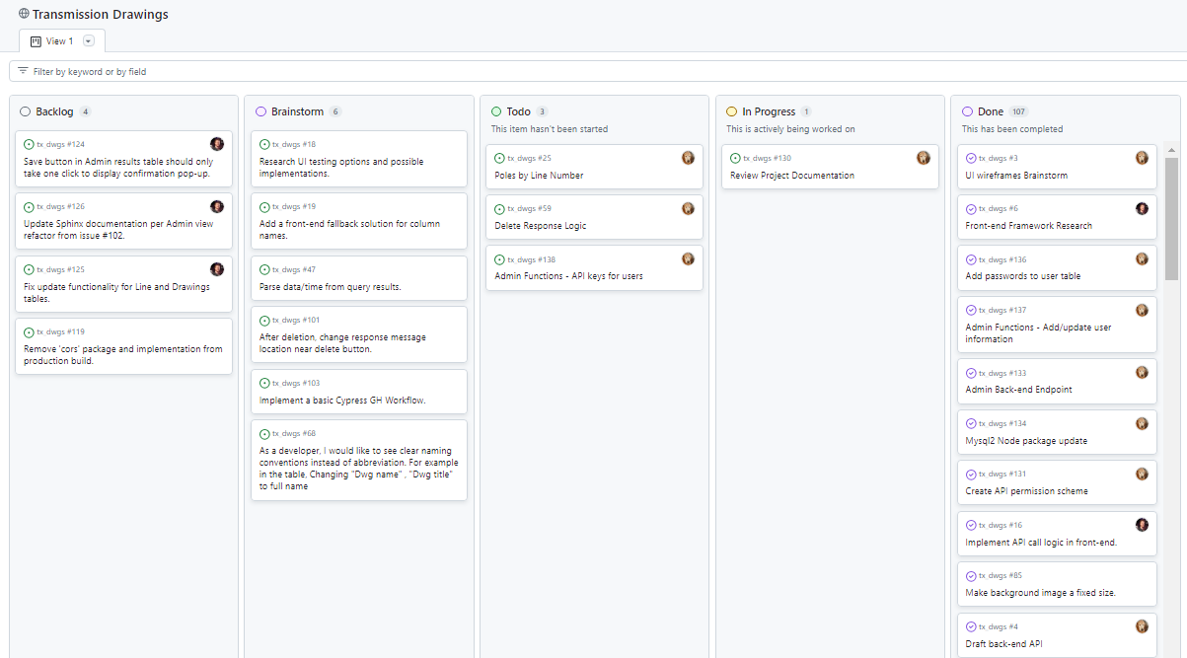
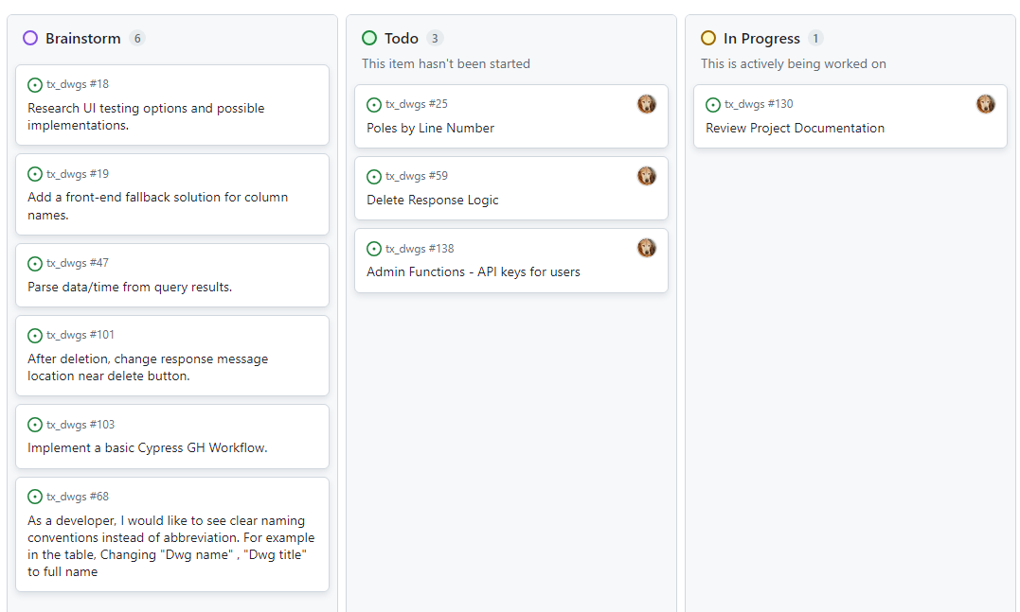
Development – Project Management
Assign roles to the project team.
Create a repository and brainstorm initial project tasks.
Set a timeline and goals, working backwards from completion to project initiation.
Make decisions on system architecture.

Slide 8
Development – My Tasks
Project manager: ran meetings, assigned tasks, tracked progress, took notes, and adjusted work and scope to meet project goals
Data wrangling: wrote scripts to manipulate data from exported tables
Back-end: was responsible for building and updating database, importing project data, and making updates to administration tables. Also built middleware (Express.js) to service API
Documentation: created Sphinx documentation for API and project

Slide 9

Development – Recent/Key Updates
Ability to store and access user passwords from the API was added. Passwords were stored using salt and secure hash.
Administration API functionality was added:
password reset,
Add new users
Revise implementation of user removal
Project documentation was revised and updated

Slide 10
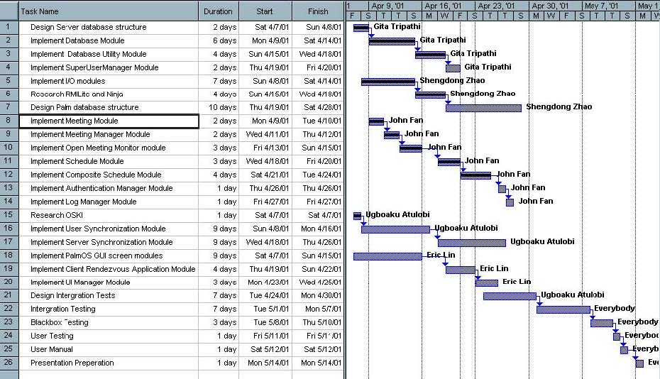
Development – Next Steps
Update the UI to add administration to the UI
Add additional administration features such as being able to update user information, display users, and review system logs
Make UI improvements based on user feedback – current implementation only received limited user testing

